Slide 1
National Transit Database
NTD Reporting for State DOTs
Report Year 2018

Slide 2
Contact Information
National Transit Database
943 Glenwood Station Lane, Suite 102
Charlottesville, VA 22901
Help Desk
(888) 252-0936
NTDHelp@dot.gov
Monday- Friday
8:00am-7:00pm Eastern

Slide 3
Presenters
Bailey Krouse
bailey.krouse.ctr@dot.gov
434-218-3275
Erik Chadwell
erik.chadwell.ctr@dot.gov
434-218-0723

Slide 4
Agenda
NTD Overview
2018 Changes and Clarifications
Interface Review and Account Management
Report Year Kickoff
Completing the 2018 Annual Report
Reporting Issues
Report Submission
Closeout Process

Slide 5
NTD Overview

Slide 6
What is the National Transit Database?
The NTD was established by Congress to be the Nation’s primary source for information and statistics on all public transportation modes of the United States.
Conditions and Performance Report
FTA’s biennial report on the nationwide capital investment needs for public transportation
Source of data for performance measurement benchmarking
Research

Slide 7
Who Reports?
All States, Tribes, and Territories benefiting from the FTA Chapter 53 funding
States report on behalf of current subrecipients (sub-grantees) that operate public transportation
Previous subrecipients of 5311 funds that have continuing grant requirements
Future subrecipients of 5311 funding (voluntary reporters)

Slide 8
Why Do I Report?
The Secretary shall:
“award a grant under section…5311 only if the applicant, and any person that will receive benefits directly from the grant, are subject to the reporting and uniform systems.”
(Chapter 53 of title 49, §5335(b), as amended by MAP-21)

Slide 9
Uses of NTD Data
Formula Apportionments
Urbanized Area Formula – $5.4 billion –
Rural Formula – $659 million –
Tribal Formula - $30 million –
State of Good Repair Formula – $2.6 billion –
Performance Benchmarking
Academic Research
Conditions and Performance Report
Government Performance Results Act (GPRA)

Slide 10
RY 2018 Reporting Deadlines
Fiscal Year End | Annual Report Due Date
June 30 | October 31*
September 30 | January 31
December 31 | April 30
*Update for RY 2018
All reporters with the fiscal year end date of June 30th will be due October 31st
Notes:
As FTA announced in summer of 2017, reporters with the FY end date of June will be due October 31st.

Slide 11
2018 Changes and clarifications

Slide 12
USOA Updates
The NTD uses uniform categories to collect public transportation financial and operating information and defines these in the Uniform System of Accounts (USOA).
Updates to the USOA and the NTD reporting requirements are intended to clarify reporting concepts to the reporters and increase the quality of the data that is collected by the NTD.
Notes:
Talking Point –
RR-20 purpose: Rural Reporters report their financial information into this form instead of the Full Reporter “F” forms

Slide 13
Changes to Rural General Public RR-20
The changes to the RR-20 form are as follows:
Reporting of fare revenues by revenue type
Passenger-Paid Fares
Organization-Paid Fares
Removal of Donations
Removal of Contract Revenues

Slide 14
RR-20 Rural Reporter
Change: Passenger Fares has split into New Object Classes:
Passenger-Paid Fares
Passenger-Paid Fares will now capture the more direct type fares that are traditionally considered as passenger fares
Examples: Full Adult Fares, Senior Citizen Fares, Student Fares, Child Fares, Fares for Individuals with Disabilities, No-show Fines
Organization-Paid Fares
Organization-Paid Fares will now capture fares earned from organizations for providing transit service
Examples: Universities, State and Local Government, Reduced Fare Reimbursements, Special Route Guarantees, Other Special Contract Transit Fares

Slide 15
Donations and Total Recoveries
Donations will now be reported to the Other Directly Generated Funding line.
All insurance recoveries are to be reported as a new revenue class called "total recoveries“.
Instead of being netted out, “total recoveries” will be reported as Other Directly Generated Funds on the RR-20.
These revenues include insurance pay outs, dividends/rebates, and funds that may be netted out towards future bills.
Notes:
Change in reporting practice not a change to the form.

Slide 16
Contract Revenues
Funding previously reported to Contract Revenues will now be reported to either:
Revenues Accrued through a Purchased Transportation (PT) Agreement
NTD Reporter or Non-NTD Provider
Full Cost Contracts
Other Directly Generated Funds
Partial Cost Contracts where the agency is unable to report the original source of funds

Slide 17
Transit Asset Management (TAM)
The forms and fields included Expanded Asset Inventory Module Reporting will be required in RY2018
State DOTs are required to offer to sponsor a group plan
Your TAM asset inventory will be more inclusive than the asset data you already report to the NTD.
New required forms: A-15, A-35, A-90

Slide 18
TAM Phase-In Schedule
Notes:
Everything you see that is required will be due on your annual due date.

Slide 19
Review: Modal Definitions
Motor Bus (MB)
Demand Response (DR)
Motor Bus service is powered by a motor and fuel contained within a vehicle. Transit agencies must report any route deviation, point deviation, or deviated fixed route as MB service.
Shared-ride demand response service is scheduled in response to calls from passengers. A transit agency employee operates demand response (DR) vehicles. Many transit systems operate DR service to meet the requirements of the ADA.
To make modal changes or updates, go to the subrecipient’s P-20 form found in their profile.

Slide 20
Review: Accounting Requirements
Accrual accounting
Revenue recorded when earned, regardless of when payment is received
A passenger purchases $10 worth of fare, but only uses $5, you would report the fare as revenue when the customer redeems the ride, not when medium is sold.
Expenses recorded when liability occurs, regardless of when payment is made
An employee receives a paycheck 10 days after it was issued. The receipt date is in a new fiscal year.
Notes:
Accounting requirements – NTD reporting requirements for financial data follow generally accepted accounting principles (GAAP) and accrual accounting.
The NTD program is a system of accounts that complies with GAAP and Standards of Governmental Accounting and Financial Reporting. However, small differences exist between NTD and GAAP, relating to the accounting of costs for capital grant purchases. If there are conflicts between GAAP and NTD reporting instructions and requirements, NTD rules are to be followed.
Accrual accounting – Revenue is recorded when earned, regardless of when payment is received. Expenses are recorded when the liability occurs, regardless of when the payment is made.
Source: www.ntdprogram.gov

Slide 21
Review: Operating Expenses
Day-to-day expenses that a transit agency incurs.
Operating and maintaining vehicles;
Maintaining other equipment, buildings, and grounds.
General Admin
Marketing & Customer support
Finance and procurement
Planning and service development
Examples:
Fuel
Salaries, Wages, Benefits
Materials and Supplies
Equipment lease and rental
Insurance

Slide 22
Review: Direct vs. Shared Expenses
To report the total costs of delivering each mode of transportation, agencies with two or more modes must calculate both direct and shared costs of providing service.
Determine which expenses are direct expenses traced to a particular mode
Determine which expenses are shared expenses
Once the shared expenses have been identified and separated from direct expenses, you may allocate the shared expenses based on an approved cost allocation method.
Notes:
Agencies have used:
Vehicle Revenue Miles
Unlinked Passenger Trips
Vehicle Revenue Hours
Number of Employees

Slide 23
Review: Capital Expenses
Expenses related to the purchase of equipment. Equipment means an article of non-expendable personal property having a useful life of more than one year
An acquisition cost which equals the lesser of
The capitalization level established by the government unit for financial statement purposes
$5,000 (Office of Management and Budget)
Examples: Vehicles, Maintenance Facilities, Equipment
When reporting new vehicle related capital expenses, please enter the expenses under the mode that the vehicle supports the majority of the time.

Slide 24
Review: Capital Assistance Spent on Operations
Capital Assistance Spent on Operations is reported when capital funding is spent on activities that are normally considered operating, such as preventive maintenance and the purchase of tires.
Please make sure to report this separately from your 5311 Operating funding (matched at 50/50)

Slide 25
NTD Key Reference Documents
NTD Glossary and NTD Annual Reporting User Guide
NTD Glossary: Glossary of NTD Terminology
NTD Annual Reporting User Guide: Step-by-step user guide for navigation and data entry within NTD.
https://www.transit.dot.gov/ntd/manuals
Uniform System of Accounts (USOA)
Outlines the basic accounting structure all NTD reporters must follow
https://www.transit.dot.gov/ntd/ntd-uniform-system-accounts

Slide 26
**NEW Reference Documents**
Policy Manual and NTD Asset Inventory Module Reporting Guide
Reduced Reporting Policy Manual: Issued annually to provide detailed guidance on what data to report to NTD
NTD Asset Inventory Module Reporting Guide: Defines expanded asset inventory data elements
https://www.transit.dot.gov/ntd/manuals
TAM Facility Performance Measure Reporting Guidebook
Transit Asset Management Guidebook: Details the methods for transit agencies regarding measuring and reporting TAM facility condition assessments to NTD.
https://www.transit.dot.gov/regulations-and-guidance/asset-management/tam-facility-performance-measure-reporting-guidebook

Slide 27
NTD Asset Inventory Reporting
Notes:
**Add new forms in this section?

Slide 28
Who does this apply to?
TAM Rule applies to all recipients of Chapter 53 funds that either own, operate or manage capital assets used in providing public transportation services.
This means:
All agencies that receive 5307 and 5311 funds (existing reporters) must comply.
Agencies that may only receive 5310, 5339, etc. may begin reporting
They must operate public transit
Recipients of 5310(b)(1)(D) funds for alternatives to public transportation that assist seniors and persons with disabilities with transportation are exempt from the requirements of the TAM rule because assets funded under the program are not used to provide “public transportation.”
Notes:
For example, the Arc of Prince George’s County, Maryland provides programs and support services for persons with developmental disabilities. Arc receives 5310(b)(1)(D) program funds and uses the funds to provide transportation services for its clients. Arc is exempt from the TAM rule because the 5310(b)(1)(D) funded assets are used to provide client-based transportation services, instead of public transportation.
Please note, participation in coordination of public transportation and human services transportation services will not automatically make 5310(b)(1)(D) recipients or subrecipients subject to the TAM rule. However, recipients and subrecipients of 5310(b)(1)(D) that also receive section 5307 or section 5311 funds are required to comply with the requirements of the TAM rule for their 5307 and 5311 funded public transportation services and assets.

Slide 29
States and TAM Plans
Any direct recipient of Chapter 53 funds which passes along some or all of those funds to subrecipients that own or operate capital assets used in providing public transportation must sponsor a group TAM plan on behalf of any of its subrecipients that are not 5307 direct recipients themselves.
This rule applies to most State DOTs

Slide 30
Review: Tier Thresholds
Tier I
Tier II
Operates Rail
Own, operate, or manage 101 or more VOMS across all fixed route mode of transportation
Own, operate, or manage 101 or more VOMS in one non-fixed route mode of transportation
Own, operate, or manage 100 or less VOMS across all non-rail fixed route modes
Own, operate, or manage 100 or less VOMS in any one non-fixed route mode
Are a subrecipient under the 5311 Rural Area Formula Program
Are an American Indian tribe

Slide 31
Participants in a State TAM Plan
Agencies must be Tier II in order to participate
May already report to NTD
Urban agencies – Will be become independent participants
Rural agencies – Will report as normal, state will complete the asset forms on their behalf (in most cases)
May be new to NTD
Managed participants
In most cases, the plan sponsor will report on their behalf
State DOT managed participant reports will be submitted along with your annual report package
Notes:
Talking point – new independent
All packages due on annual report due date

Slide 32
interface review and user management

Slide 33
NTD Home Page: www.transit.dot.gov/ntd

Slide 34
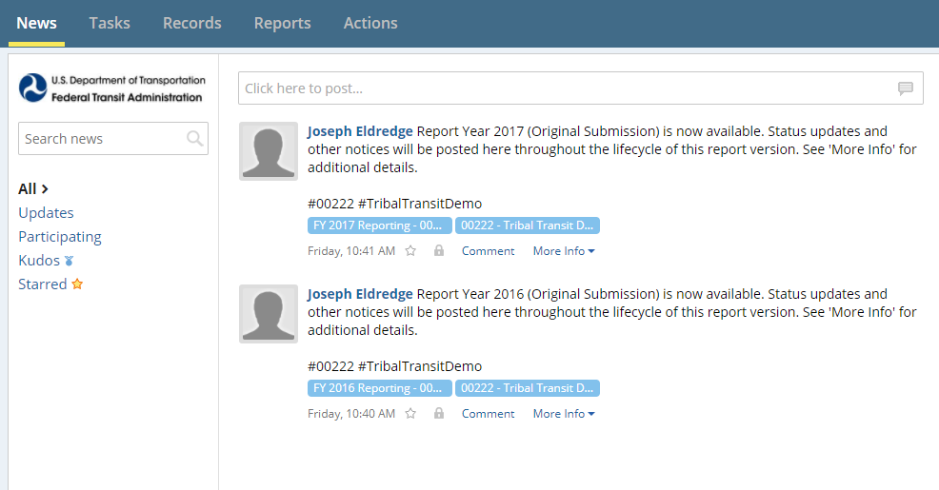
Interface Review - News
All users land on the News feed
Updates from NTD staff will display here

Slide 35
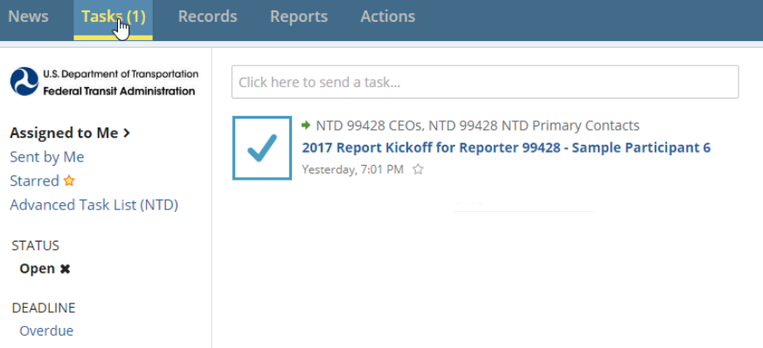
Tasks
Tasks are assigned to CEOs, CEO delegates, and NTD Contacts
Typically prompted by incomplete/unsaved forms

Slide 36
Records
Agency reporting forms and profile information are accessed through “Records”

Slide 37
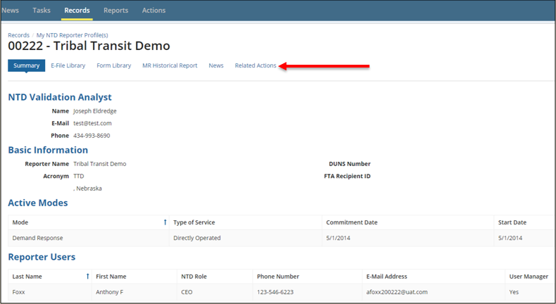
Reporter Profiles
These forms contain data that normally doesn’t change from year to year:
Basic Information (P-10)
Reporter Modes (P-20)
Report Users (P-30)

Slide 38
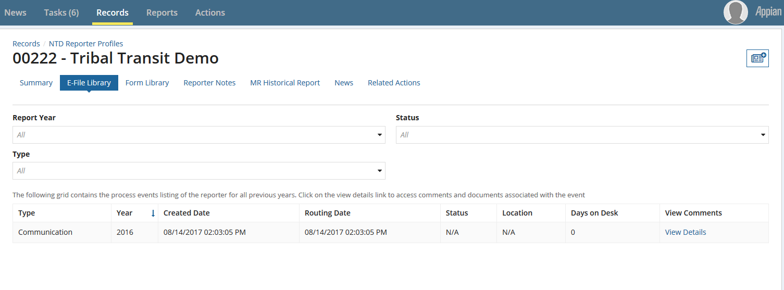
Reporter Profile – E-File and Form Library
E-File Library - Filter through communications
Form Library - Search for data from previous years or revisions

Slide 39
Reporter Profiles
Related Actions
View and Manage Profile Forms
Print Annual Package
Manage Transit Asset Sponsor

Slide 40
User Manager
Each agency must submit an official letter designating an employee as the User Manager (UM).
User Managers create accounts for the CEO and NTD Contact as well as accounts for editors and viewers.
The UM can also fill a NTD Role - for example, the CEO can also be the agency’s UM.
FTA FACES User Guide (User Management) found in the following link under System Reporting Guides: https://www.transit.dot.gov/ntd/manuals

Slide 41
Permissions by Role
CEO & CEO Delegate:
Create reporter requests (waivers, extension requests, etc.)
Submit annual report package
View and edit forms and issues
NTD Contact:
Submit all annual report after the original submission by the CEO
View and edit forms and issues
Editor:
View and edit forms and issues
Viewer:
View forms and issues

Slide 42
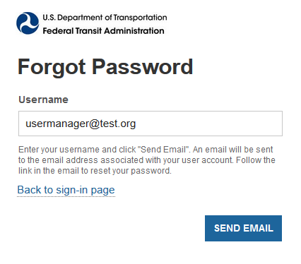
Resetting Passwords
Click “Forgot Password” from main login screen
Enter the email address used for your user name (all lower case) and click
“Request Password Reset”
A link will be sent to your email
and will expire in 15 minutes.
Follow the procedure again if the
15 minutes has passed.
Notes:
Inactive Users:
Locked out after 60 days of inactivity
Once user account is locked, the system
will send an auto generated email alerting
the user their account has been locked.

Slide 43
Unlocking User Account
There are two methods to unlock an account
1. The user can unlock their own account using security questions.
Go to Actions > Answer Security Questions
You will have three attempts to correctly answer
2. The user can submit an unlock request; it will go to their User Manager for further action.
Go to Actions > Request to Unlock Account
UM will get new Task to unlock the user account once logged into the system.
Must use this option if questions haven’t been created
Notes:
Talking Point:
If a User Manager is locked and they have not set up security questions, they will submit an unlock request and follow up with their analyst for processing.

Slide 44
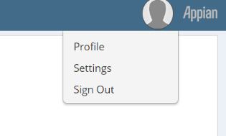
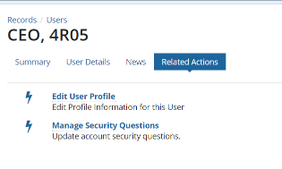
Creating Security Questions
Under your Profile name select “Profile” from the dropdown menu
Select Related Actions from the top list
Select Manage Security Questions
The Manage Security Questions Screen will populate to complete three questions.
Notes:
Iffy on shots

Slide 45
Self-Reporting Subrecipients
Subrecipients have the ability to enter and edit their own data within the National Transit Database (NTD) online reporting system.
Completely optional
State DOT CEO/NTD Contact can grant self-reporting privileges to some, none, or all at their discretion
Grants subrecipients ability to save forms, not submit
Subrecipients should contact the state for technical assistance with the reporting system
All correspondence with the NTD analyst, via email or phone, should go through the State Contact or include the State Contact

Slide 46
Standard Procedures: Self-Reporting
Subrecipients taking part in self-reporting will be required to submit a User Manager letter for accounts in the NTD Reporting System
Self-reporting subrecipient users are subject to User Management requirements
DOTs should send User Manager letters to their assigned analyst
NTD will not be able to process or accept User Manager letters sent directly from subrecipients

Slide 47
Report Year kickoff
Notes:
The Report Kickoff process officially launches the upcoming Report Year for your agency
As soon as your fiscal year ends, you will receive a “Task” to complete the kickoff
This process generates your report package forms after you confirm your agency’s basic operating information

Slide 48
Report Year Kickoff – State DOTs
From the Task tab, click on the Report Year Kickoff
“Accept” the task and then select “Proceed”
Note: the kickoff task is only available to the CEO, CEO Delegate, and NTD Contact

Slide 49
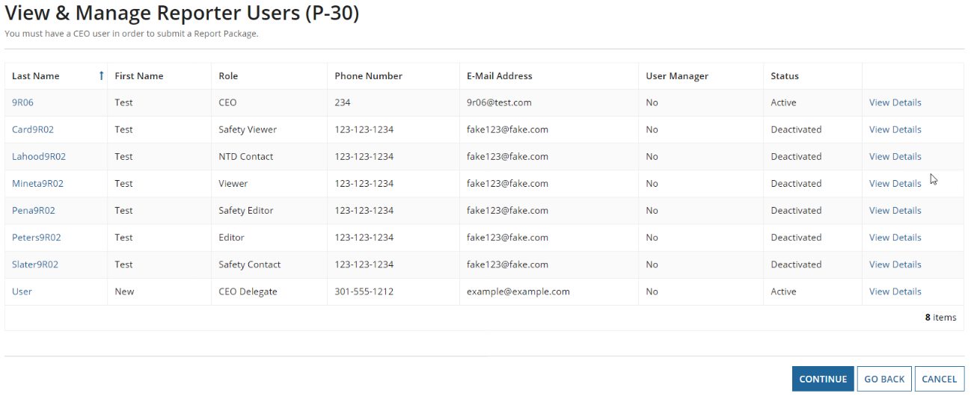
Verify DOT Information
Update Users
The CEO, NTD Contact, and User Manager (UM) can edit user roles
Only the UM can add new users
Individual users can edit their own profile
Notes:
First step is to confirm users for your agency

Slide 50
Identifying Subrecipients
Identify Subrecipients
Subrecipients from RY2017 are pre-loaded. Please verify this list.
New subrecipients can be added from a list of existing agencies or created during kickoff.

Slide 51
Assign Subrecipient Type
Assign Subrecipient Type
The type is pre-loaded from RY2017 Closed Report.
To change, select an option from the dropdown menu under “Subrecipient Type”
Before changing subrecipient type from Rural General Public Transit service to another type, please consult your analyst.
Notes:
Need state Kickoff Task

Slide 52
Assign Participation
Assign Participation in State TAM Plan
States will be required to identify asset participants during this step
Your Rural General Public subrecipients participant boxes will be automatically checked off
Any Reduced Asset Reporters either new or previously existing, will also have the box checked. In this case the box cannot be unchecked.
Notes:
Talking point – An independently reporting agency i.e., a 5307 recipient will select their group plan sponsor during kickoff.
Go thru RGPTs, then Independents, then new asset reporters

Slide 53
Assign Self-Reporting Privileges
Assign Self-Reporting Privileges
To select the subrecipient, check the box to its left.
Once all are selected, finish the kickoff

Slide 54
Complete Report Year Kickoff
Form Generation
Profiles and Report Packages (Annual Forms) take at least three minutes to generate
Note: Newly created subrecipients and reduced asset participants will require NTD approval before generating
Click “OK” to end the task
The process is not complete until you see this message.

Slide 55
Completing the 2018 Annual Report

Slide 56
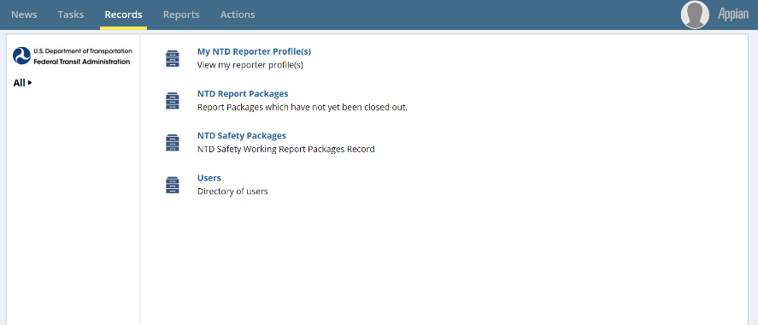
Updating Report Packages
Step 1: Click on Records
Step 2: Click on NTD Report Packages
These packages will contain the annual forms for all of your subrecipients
Notes:
150

Slide 57
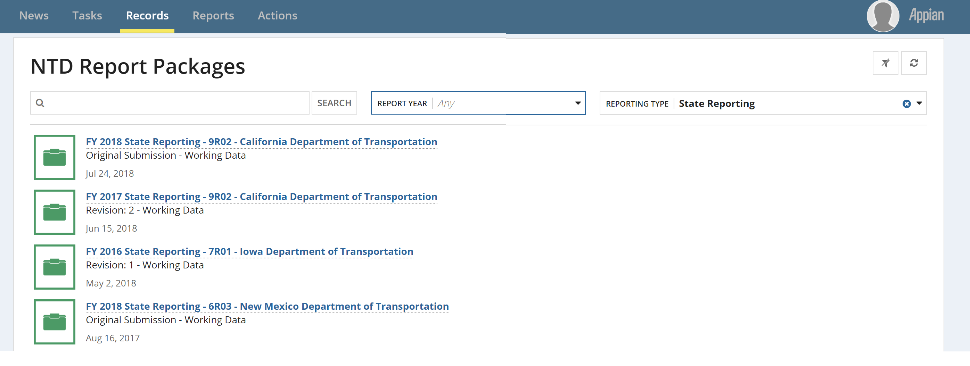
Package Selection
Step 3: Select the State Package to review all subrecipient package or the individual package you want to edit
Notes:
Need to format pic

Slide 58
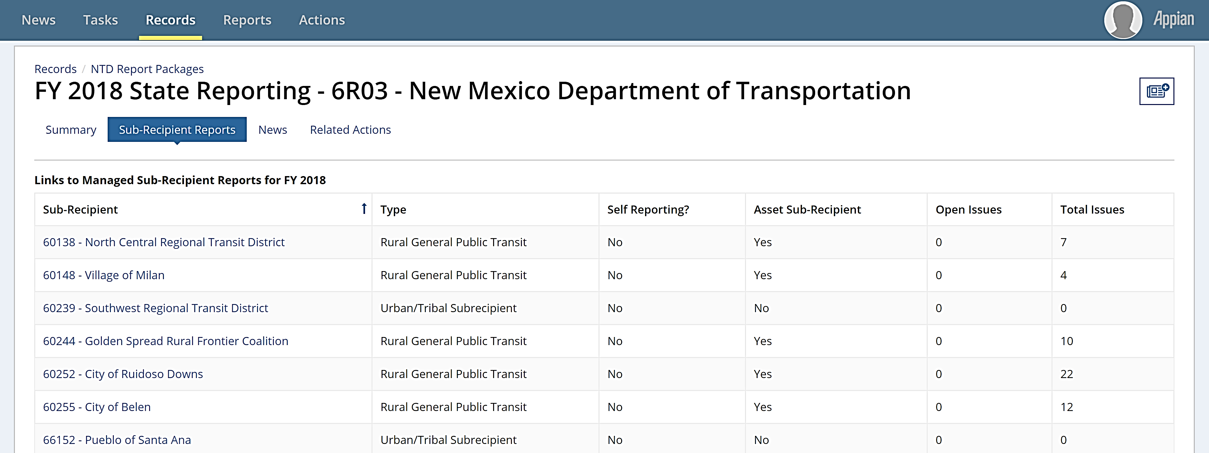
Report Year Kickoff Steps
Step 4: Select “Sub-Recipient Reports” then select the package you want to work on
Helpful Hint: You sort the table by clicking on the headings
Application: Sorting on Open Issues to review which subrecipients have remaining issues to resolve

Slide 59
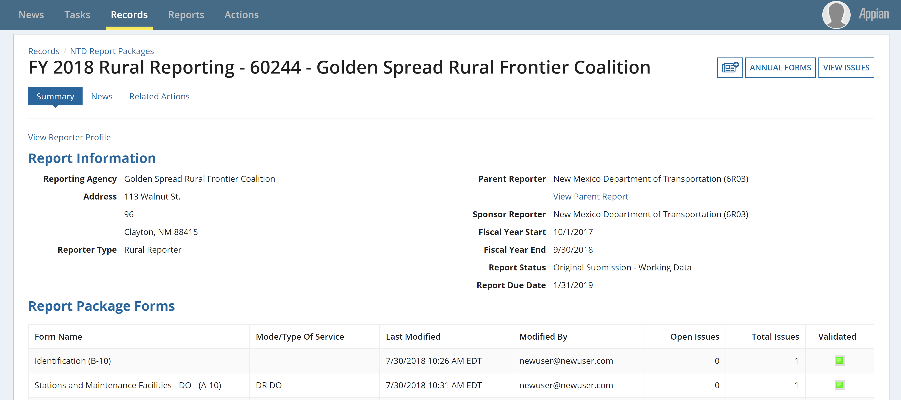
Select Annual Forms
Step 5: Select “Annual Forms” to be brought to the editable list of forms

Slide 60
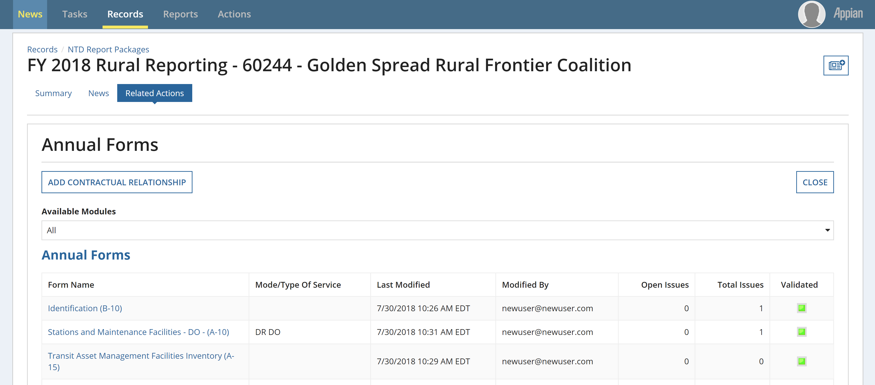
View Form
Step 6: Click the hyperlinked form name
Notes:
150

Slide 61
Subrecipient types and forms
Annual Forms

Slide 62
Rural General Public Transit (RGPT)
Definition: Agencies that provide rural service and receive or benefit from 5311 funding. (Does not include those receiving §5307 funding or Tribes)
Required Forms:
B-10: Organization Type and Fiscal Year End Date
A-10: Maintenance Facilities (one per mode)
A-15: Transit Asset Management Facilities Inventory
A-30: Revenue Vehicle Inventory (one per mode)
A-35: Service Vehicle Inventory
RR-20: Reduced Reporting
Financial Data
Service Data
Safety Data
Volunteer Data

Slide 63
Reduced Asset Subrecipient
Definition: Agencies that receive or benefit from FTA funding (Chapter 53) other than§5307 or§5311 funding (e.g., §5310), and owns, manages, or operates an FTA-funded capital asset used in providing public transportation services.
Required Forms:
B-10: Organization Type and Fiscal Year End Date
A-15: Transit Asset Management Facilities Inventory
A-30: Revenue Vehicle Inventory (one per mode)
A-35: Service Vehicle Inventory

Slide 64
Urban/Tribal Subrecipients
Definition: Transit agencies that commonly provide service to both Urban and Rural areas, may receive or benefit from §5307 funding.
Required Forms:
B-10: Organization Type and Fiscal Year End Date
RR-20 Urban/Tribal Subrecipient
Section 5311 Funds

Slide 65
Intercity Bus Subrecipients
Definition: Regularly scheduled bus service for the general public that:
Operates with limited stops between two urbanized areas;
Connects rural areas to an urbanized area; or
Has the capacity for transporting luggage.
Required Information:
B-10 - Organization Type and Fiscal Year End Date
RR-20 Intercity Bus Subrecipient
Section 5311 Funds
Vehicle Revenue Miles travelled during §5311 revenue service.
Unlinked Passenger Trips during §5311 revenue service.

Slide 66
B-10
Basic Information

Slide 67
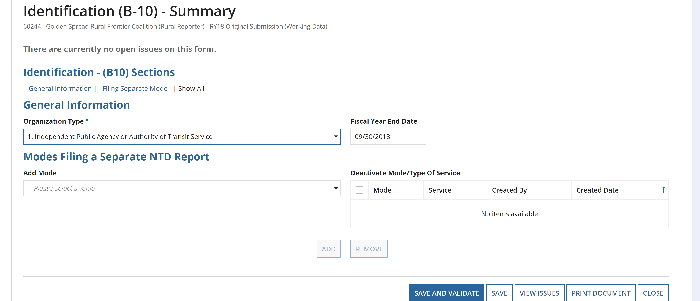
General Information
Once the B-10 form is open:
Select an Organization Type from the drop down menu.
Update the Fiscal Year End Date.
Dependent on what dates the data are from – may be different from the State’s FY.
“Save and Validate” and “Close” when finished.
Notes:
*May need to edit wording

Slide 68
A-10
Stations & Maintenance Facilities

Slide 69
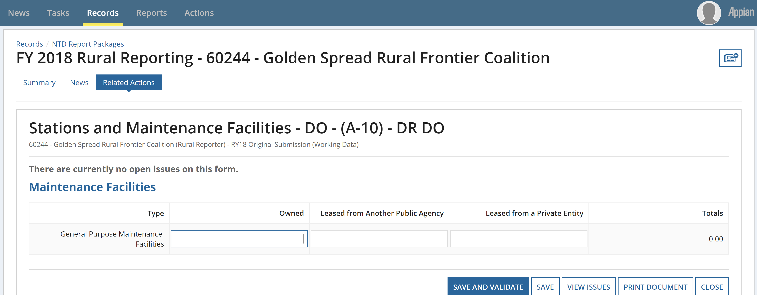
Enter Data and Click Save
Once the A-10 form is open:
Enter Data and Click “Save and Validate”
If facility is used by more than one mode, report a pro-rated share based on the amount of vehicles it services

Slide 70
Example: Allocation of Assets
A subrecipient operates a Demand Response (DR) service and a fixed-route bus (MB) service
Subrecipient owns 1 maintenance facility
Subrecipient owns 20 vehicles total – 15 used for DR and 5 used for MB
DR A-10 Form shows .75 for Owned Facility
(15 DR Vehicles/20 Total Vehicles) = 0.75 owned
MB A-10 Form shows .25 for Owned Facility
(5 MB Vehicles/20 Total Vehicles) = 0.25 owned

Slide 71
A-15
Asset Inventory Management - Facilities Inventory
Notes:
Starting with the A-15 we are going to start talking about the new forms required under the expanded asset inventory. Any new data elements that we’re talking about adding this year as in the data in the A-15 and A-35 will act like the A-30 in that you will only have to enter the data once and going forward to RY19 and on you will need add new assets.

Slide 72
Facilities Inventory - What to Report
Administrative and Maintenance Facilities for which the agency has Capital Responsibility.
Passenger/Parking Facilities that are used in revenue service – Regardless of Capital Responsibility
Capital Responsibility
An agency has direct capital responsibility for an asset if any of the following are true:
The agency owns the asset,
The agency jointly owns the asset with another entity, or
The agency is responsible for replacing, overhauling, refurbishing, or conducting major repairs on an asset, or the cost of those activities is itemized as a capital line item in the agency’s budget.

Slide 73
Asset Management Facilities Inventory
Examples of Facility Types (more found in Policy Manual page 82)
Administrative buildings
Facilities and offices which house the executive management and supporting activities for transit operations, with the exception of vehicle maintenance
Combined Administrative and Maintenance Facility
Any facility with combined functions of at least one of the administrative facilities listed above and one of the maintenance facilities listed above.
If selected, describe specific facility in “Notes” field in form.
Maintenance facilities
Facilities were routine maintenance and repairs or heavy maintenance or unit rebuilds are conducted. Agencies must not report maintenance facilities where third-party vendors perform services, such as a local gasoline service or body shop.
Notes:
Admin buildings: Activities include accounting, finance, engineering, legal, safety, security, customer services, scheduling and planning.

Slide 74
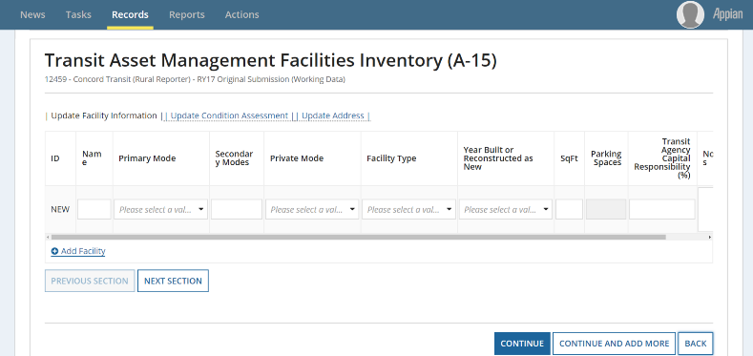
A:15 – Add a New Facility
To add a new facility, click “Add Facility”
May add multiple facilities at once if you choose to
There are three sections to this form:
Update Facility Information, Update Condition Assessment, and Update Address

Slide 75
A-15 – Update Facility Information
Name
Primary Mode ― Pull-down Menu
Secondary Modes ― Type two-letter code
Private Mode ― Pull-down Menu
Facility Type ― Pull-down Menu
Year Build or Reconstructed as New
Square Feet/Parking Spaces ― Choice based on facility type
Capital Responsibility – Entered as a percentage

Slide 76
A-15 - Update Condition Assessment
Agencies must report a condition assessment for having capital replacement responsibility, but not if they are under construction.
Pull-down of integer values 1-5
Methodology (NTD web site)
TAM Facility Performance Measure Reporting Guidebook: Condition Assessment Calculation (April 2017)
Date of Assessment

Slide 77
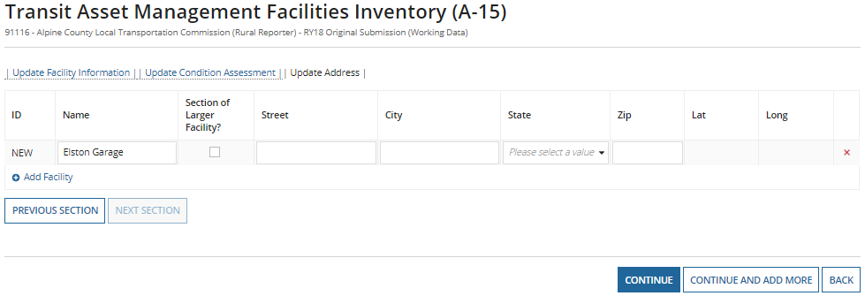
A-15 – Update Address
Name will populate from previous sections
Add the address of the facility
When complete, click “Continue”

Slide 78
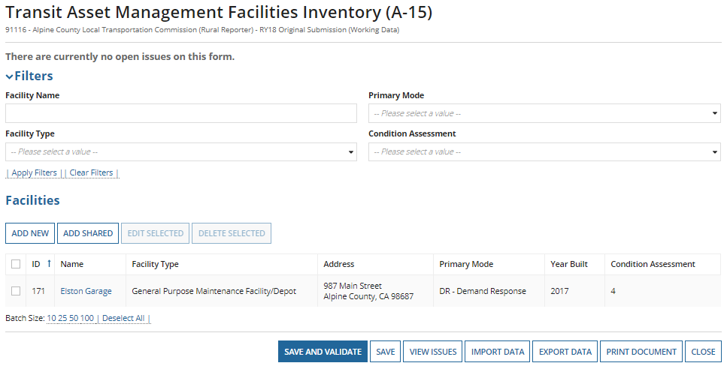
A-15 Summary and Saving
Once all information is entered, you can edit, delete, or “Save and Validate” the data entered.
Edit by clicking the radio button then “Edit Selected” or by clicking on the name of the facility.

Slide 79
A-30
Revenue Vehicle Inventory

Slide 80
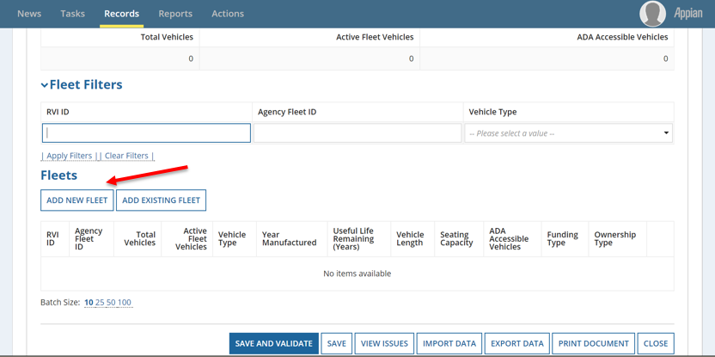
A-30: Revenue Vehicle Inventory
Fleet information is pre-populated from the 2017 Report Year.
Add new fleets or edit existing fleets
Notes:
Continues to :
Categorize vehicles in fleets
Identify basic vehicle information
Indicate vehicle funding and ownership types

Slide 81
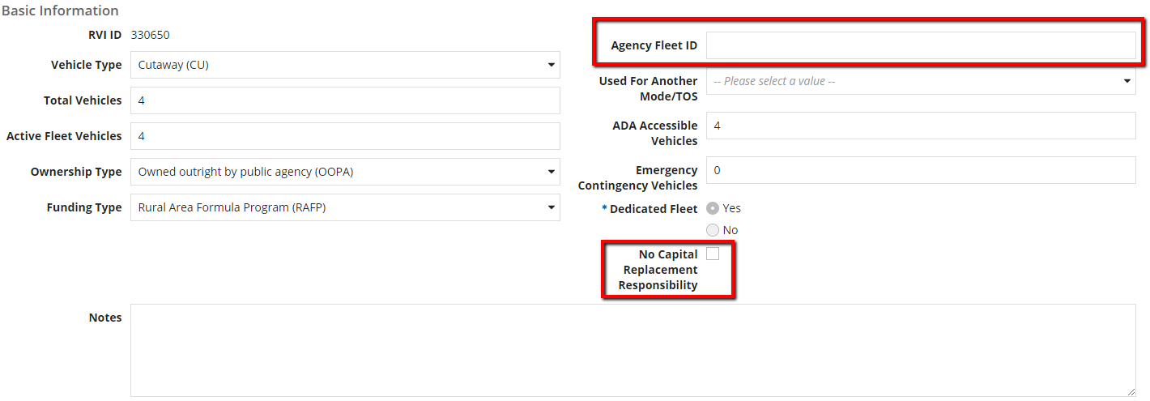
A-30 Fields Introduced in RY2017
Agency Fleet ID – If an agency uses an internal tracking number for their fleet
No Capital Replacement Responsibility – If the agency or sponsor has no capital replacement responsibility towards the fleet, they will check the box. This will remove the requirement for reporting a useful life benchmark.
Notes:
Talking point – if you as the state has capital responsibility, please make sure you leave this box unchecked.

Slide 82
A-30 Fields Introduced in RY2017
Agencies are required to report a useful life benchmark for all fleets for which they have capital replacement responsibility for.
FTA has outlined default useful life benchmarks for each vehicle type, but transit agencies may adjust the ULB as applicable.

Slide 83
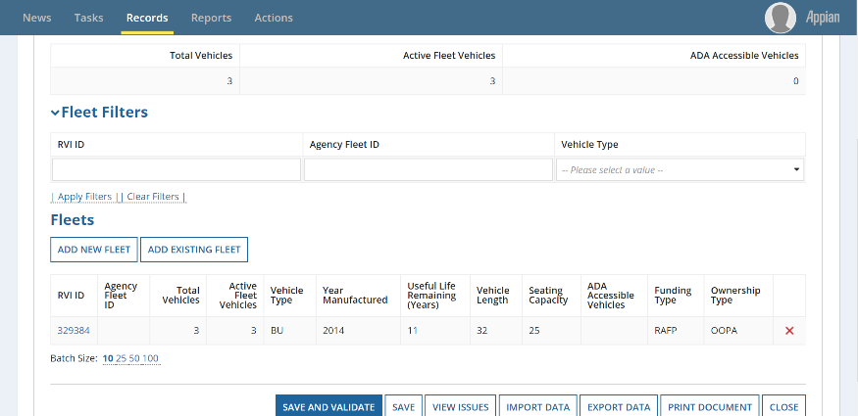
New RVI
Once finished, Click “Save and Validate”
Saving assigns the RVI ID
Click “Add Fleet” to add another or “Close” to go back to the list of annual forms.

Slide 84
Review: Manufacture Year
Transit agencies are required to report the year the vehicle was manufactured and built, not the vehicle model year.
The manufacture year will typically be different than the model year for the vehicle(s).
Correctly labeling this will help further determine the useful life benchmark of the vehicle and fleet.

Slide 85
Review: Active vs Inactive Vehicles
Transit agencies must report the number of active vehicles in fleet at fiscal year end
Active Vehicles
Regularly provide revenue service
Includes spares/backups and vehicles temporarily out of service for routine maintenance
Inactive Vehicles
Vehicles that have been sold or awaiting sale
Vehicles in storage and FTA emergency contingency plan
Vehicles out for long-term, major repairs

Slide 86
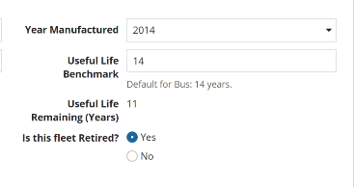
Review: Retire vs Deleting Fleet
Retire
Retire a fleet when there are no more active vehicles.
When a fleet is no longer in use, change Active Vehicles to 0, and the “Is This Fleet Retired?” notification will appear.
Delete
Delete a fleet ONLY if it is mistakenly included in the A-30 form.
Notes:
Explain retired vs inactive

Slide 87
Common Validation Issues
Shared Fleets do not match across modes
If a fleet is shared between modes, enter data on the first mode, then on the second mode’s A-30 form select “Add Existing Fleet” and select the applicable fleet and add.
New Vehicles, no Capital Funding Reported
If you report new vehicles, you must also report the capital purchase on the RR-20
Missing Data
All fleet data must be reported prior to submission

Slide 88
A-35
Asset Inventory Management - Service Vehicle Inventory

Slide 89
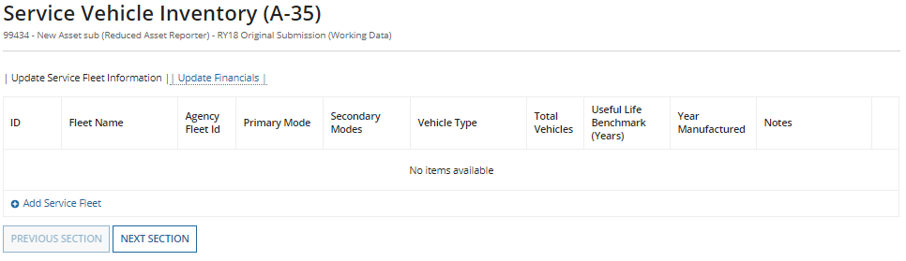
A-35 Service Vehicle Inventory
Agencies are required to report on service vehicle fleets for which they have capital responsibility.
Service Vehicles are defined as:
Road worthy, self-propelled or major pieces of construction equipment that are used to support revenue operations, maintain revenue vehicles, or perform transit-oriented administrative activities
Examples: Cars used for admin staff, transit police cars, tow trucks, service trucks, etc.
Agencies should not report small fork lifts, golf carts, etc.
Notes:
The form works the same way as the A-15
To create a fleet you will select “Add New”

Slide 90
A-35 – Update Service Fleet Information
Service Vehicles are categorized into three types
Automobiles
Truck and other rubber tired vehicles
Steel wheel vehicles
Notes:
Talking point – point out primary mode vs secondary

Slide 91
A-35 – Update Financials
Estimated Cost
Full cost to replace the fleet
Year Dollars of Estimated Cost
Corresponding year to the dollar value reported
Once complete click “Continue”
Notes:
Estimated Cost:
Include soft costs such as finance charges
The most recent estimate of the full cost to replace the assets
If you do not have a recent estimate, you can report the original cost of the asset or its insured value
Year Dollars of Estimated Cost
For example, if you do not have a recent estimate and do not know the insured value, and you report the original cost of the assets, you would report the year that you purchased the asset
If you have an insured value from your last fiscal year, you would report the year that it corresponds to

Slide 92
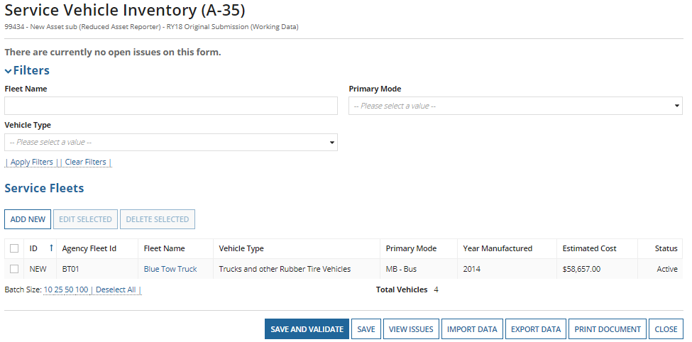
A-35 Summary and Saving
Once all information is entered, you can edit, delete, or “Save and Validate” the data entered. (same as A-15)
Edit by clicking the radio button then “Edit Selected” or by clicking on the fleet name.

Slide 93
RR-20
Rural General Public Transit (RGPT)

Slide 94
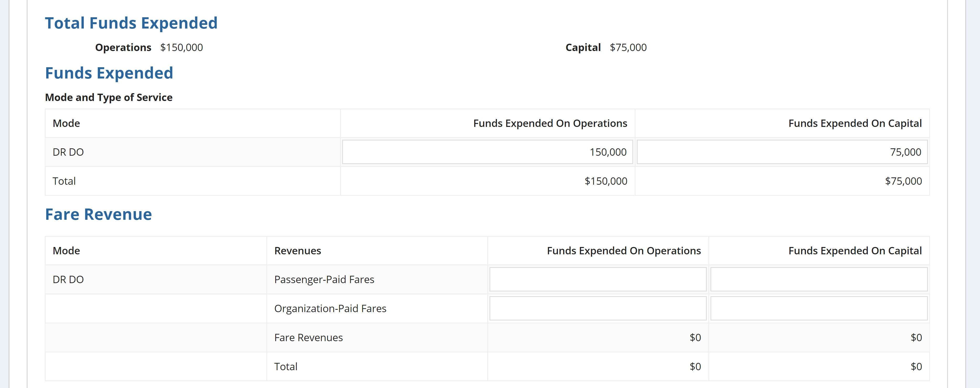
Total Funds Expended
Once the RR-20 form is opened, enter the following financial info:
Annual expenses by mode
(Total Funds Expended need to match show in red circles)
Expended fare revenues by mode

Slide 95
Financial Information
Report revenues expended, NOT earned
The grant award amount can be larger than the amount actually expended
Reporters must
Report the original source of funds
Report the total amount used for reimbursement NOT the total grant or award.
Example: An agency receives a $750,000 grant and expends $300,000 during the fiscal year.
Solution: The agency report would an expenditure of $300,000 to NTD

Slide 96
Fare Revenues
Fare revenues represent all income received and expended directly from passengers. This includes:
Any donations received on board as payment for a ride, either suggested or unsolicited, should be recorded as fare revenues.
As mentioned previously, fare revenues were broken into Passenger-Paid Fares and Organization-Paid Fares starting RY2018.
Notes:
Passenger-Paid Fares
Passenger-Paid Fares will now capture the more direct type fares that are traditionally considered as passenger fares
Organization-Paid Fares
Organization-Paid Fares will now capture fares earned from organizations for providing transit service

Slide 97
Allocating Fare Revenues
Agencies with more than one mode are required to capture and report fares expended from each mode separately and not allocate based on a data point
Exceptions to this requirement happen when:
There is a fixed fare for the initial segment of a multi-mode trip and the transfer charge is not equal to the fare charged for a single ride trip on the next mode;
A large portion of passengers use prepaid fare media that is accepted on all modes.
If your agency is an exception to the rule, please make sure to explain your methodology during the validation process

Slide 98
Other Directly Generated Funds
Other Directly Generated Fund examples:
Advertising Revenues
Concession Revenues
Fundraisers
Park and Ride Revenues
Interest on Investments
Non-full cost contracts
Donations and Insurance Recoveries – New for RY18

Slide 99
Non-Federal Funds
Required to describe Other Non Federal Funds.
These include any Non-Federal grants that are not covered by the above funding types. These are typically not dedicated to transit or from the annual budget. (Sale of asset)

Slide 100
Local and State Funds
Local sources:
Tax levies
General Funds
Specified contribution
Finances from the local entities
State sources:
State programs that support public transit
Includes State portions of Medicaid Fund
Notes:
Financial assistance from local entities that support the operation of the transit system. They include, but are not limited to:
Tax levies: A specified amount from local levies that is dedicated to supporting public transit system operating costs;
General funds: Transfers from the general fund of local governments to cover the Local Share portion of the transit system budget;
Specified contributions: Contributions from city, county or other municipal government towards the Local Share portion of the transit system budget

Slide 101
Federal Funds
Select your Federal Funding source
“Other Federal Funds” and “Other FTA Funds” require a description

Slide 102
Federal Funding Section - Other Funds
Other FTA Funds
Funds from an FTA grant not listed
FTA Clean Fuels Program (5308)
Other Federal Funds
Funds from a Federal grant not listed
Housing and Urban Development (HUD), Department of Health and Human Services (HHS), Federal Highway Administration (FHWA)
Medicaid
Notes:
Other USDOT
Funds from other USDOT agencies such as Federal Highway Administration, Federal Rail Administration

Slide 103
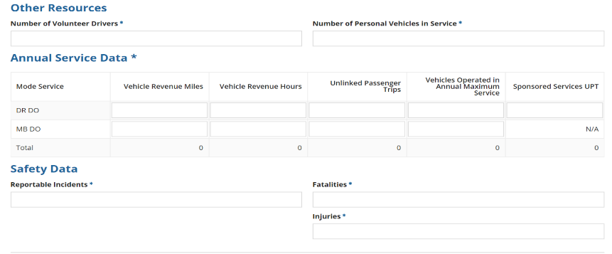
Resource, Service and Safety
Data is required in all fields
Volunteer Resources, enter zeroes
Reportable Incidents, enter zeroes
Notes:
A common error is to leave the Reportable Incidents and/or volunteer resources blank, if you did not have any incidents or do not have volunteer resources, please make sure to enter zeroes.

Slide 104
Revenue Service
A transit vehicle is in revenue service when it is providing public transportation and is available to carry passengers.
Service data should include:
Miles and hours when vehicle is in revenue service
Layover/Recovery Time
Service data should exclude:
Deadhead
Training
School Bus or Charter Service
Maintenance Testing
Fueling
Lunch Breaks

Slide 105
Deadhead
Agencies must exclude deadhead when reporting service data
When transit vehicles are deadheading, they operate closed-door and do not carry passengers.
Deadhead includes:
Leaving or returning to the garage or facility to or from the starting or ending point of revenue service
Changing routes
When the driver does not have the duty to carry passengers
Please see the NTD Policy Manual for further clarifications between Revenue Service and Deadhead for each Mode.
Notes:
Garage to first stop & Last stop back to garage
Please see the NTD Policy Manual for further clarifications between Revenue Service and Deadhead for each Mode.

Slide 106
Unlinked Passenger Trips
Unlinked Passenger Trips are Total passenger trips (regular + sponsored trips)
These are the number of passengers who board public transit vehicles.
Passengers are counted each time they board the vehicle no matter how many vehicles they use from their origin to their destination

Slide 107
Sponsored Trips
Sponsored service is paid, in who or in part, directly to transit provider by a third party.
These services may be offered by transit providers as part of a Coordinated Human Services Transportation Plan.
Common sponsors include the Veterans Administration, Medicare, sheltered workshops, The Arc, Assisted Living Centers, and Head Start programs.
Sponsored Trips are a subset of total UPT.
Total UPT = Non Sponsored UPT + Sponsored UPT

Slide 108
VOMS
Vehicles Operated in Annual Maximum Service (VOMS)
The number of revenue vehicles an agency operates to meet the annual maximum service requirement
Count VOMS based on the peak season of the year on the busiest day
Excludes atypical days or one-time special events
Do not report highest number of vehicles available for service; report vehicles actually operated
Notes:
Vehicles operated in maximum service (VOMS) – Number of vehicles scheduled for the peak service on a typical day. It does not include:
Number of vehicles operated on atypical days such as holiday celebrations (e.g., Fourth of July), one-time special events (e.g., World Series celebrations, political conventions), or spare vehicles.
Vehicles in routine or extended maintenance, emergency contingency, and vehicles awaiting sale.
Source: www.ntdprogram.gov

Slide 109
Revenue Service Example
Bob’s Dial-a-Ride cutaway departs from garage at 10:45, drives 3 miles to pick-up point
Arrives at 11:00, 5 passengers board vehicle at 11:02
Drops off passengers at destination 3 miles away at 11:15
Resulting Data
3 vehicle revenue miles
0.25 vehicle revenue hours
5 unlinked passenger trips

Slide 110
Safety Data
Reportable Incidents include:
Fatalities, injuries, or property damage >$25,000
Collisions involving revenue vehicles that require towing away from the scene for either vehicle involved
An evacuation for life safety reasons
Fatalities are reported when deaths occur within 30 days of the event
Injuries are reported when passengers are immediately transported away from the scene for medical attention
If no reportable incidents, enter “0” in all fields

Slide 111
Reporting issues

Slide 112
Common Clarifications
Reporting scheduled hours or driver’s availability instead of actual vehicle revenue hours
Calculating vehicle revenue miles based on routes or odometers
Including deadhead in revenue service.
Reporting only Federal Funds
Agencies should report total operating expenses to show the true cost of transit service including matching sources

Slide 113
Common Clarifications
Funds Expended on Operations or Capital
Does not match Sources of Funds identified for Operations or Capital
VOMS reported is equal to or higher than Active Vehicles on the A-30 Form for corresponding mode
VOMS are the amount of vehicles on the road at once during peak service times – not total available (VAMS)
Reporting more Sponsored Unlinked Passenger Trips than Total Unlinked Passenger Trips
Total UPT includes the Sponsored UPT subset
Notes:
How do I report data for a subrecipient that has a contract with a Tribe (NTD direct recipient) in which they are the seller of service?
The service data that the Tribe is buying under the terms of their fully allocated contract will be reported on the Tribe’s report.
The service that is not being paid for will be reported by the subrecipient.

Slide 114
Key Performance Ratios
Cost per Hour (CPH)
The average cost to operate one vehicle for one hour of revenue service.
Operating Expenses divided by modal VRH.
Trips per Mile – (TPM)
How many passengers per revenue mile.
Modal UPT divided by modal VRM.
These are commonly raised when there is a deviation of data compared to the prior year or if the data calculations are higher or lower compared to other Rural Transit systems
Notes:
Reasoning for increase/decrease examples

Slide 115
Intercity Bus
If the §5311(f) funds expended are for only planning activities or capital projects and are not expended for operations, do not complete the VRM and UPT data fields.
If a route is only partially subsidized by the §5311 funds, report all the VRM and UPT for that route—it is not necessary to track or allocate service for a partial subsidy of the route.

Slide 116
Urban/Tribal Subrecipient
5311 Funding not matching between the State’s RR-20 form and the directly reporting subrecipient’s form (RR-20/F-10).
If the State and subrecipient operate on the same fiscal year, the amounts between the forms should match
Report only the 5311 funding that the State grants the agency
Please note Tribes can receive State granted 5311 funding in addition to 5311 Tribal Transit Funds
Tribes receive Tribal Transit Funds directly from FTA – do not include this funding type on the tribal subrecipient RR-20

Slide 117
RU-30
Statewide Characteristics

Slide 118
Statewide Characteristics
§5311 Expended on State Administration
§5311 revenues expended on state admin cost as a result of administering the program.
Number of Counties with§5311 Service
Total number of counties in the state that are currently served, in whole or in part, by§5311 funded operators. States are to include counties that are served by directly-reporting Indian tribes in this total.
A county is served if the subrecipient picks up or drops off passengers.

Slide 119
A-90
Transit Asset Management Performance Measure Targets

Slide 120
What is the A-90?
Agencies report the portion of their assets that have met or exceeded the “Useful Life Benchmark”
Compares current year targets to actual data pulled from current year asset forms.
Vehicles
Useful Life Benchmark (A-30 & A-35)
Facilities
Condition Assessment (A-15)
Reporting on behalf of their managed and independent participants. This form represents the plan for whole group

Slide 121
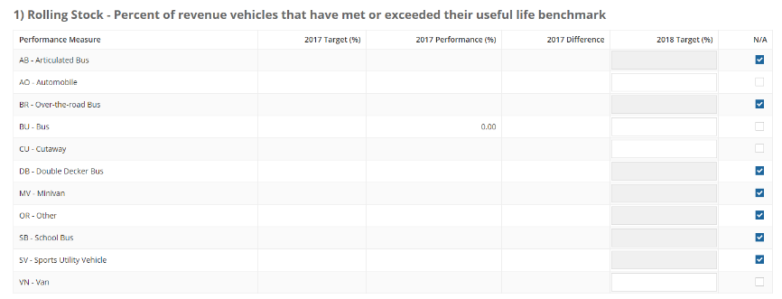
A-90 Sections: Rolling Stock
Refers to vehicles used in revenue service (A-30)
Vehicle types are populated from active modes. Select N/A for vehicle types your agency doesn’t operate.

Slide 122
A-90 Sections: Equipment
Refers to service vehicles used to support revenue service (A-35)
Automobiles
Truck and other rubber tired vehicles
Steel wheel vehicles
Notes:
Equipment – Service Vehicles
Report based on the three vehicle types in A-35

Slide 123
A-90 Sections: Facilities
Refers to facilities used in revenue service and those used to support revenue service (A-15)
Report the percentage of facilities that rate below a 3 on the condition scale.
You can also submit your agency Narrative Report
This outlines performance targets and your agency’s progress towards those targets and may include any changes to transit system.
Notes:
Facility – Report the percentage of facilities that rate below a 3 on the TERM Scale
Submit your agency’s Narrative Report at the bottom of the A-90 form – Due RY2019
Outlines performance targets and your agency’s progress towards those targets
May include any changes in transit system

Slide 124
Report Submission

Slide 125
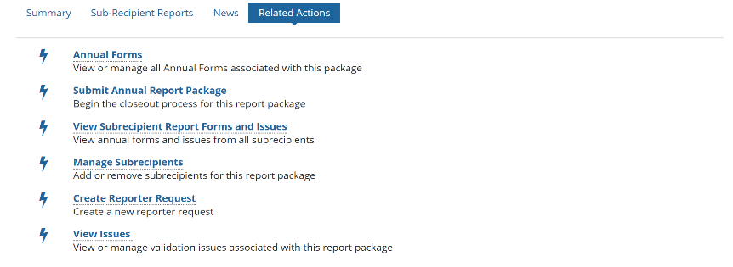
How to Submit
Step 1: Open the State Package and click on “Related Actions”
CEO and CEO Delegate can submit the Original Submission
NTD Contact is able to submit any revisions after OS.
Step 2: Click Submit Annual Report Package

Slide 126
Unable to Submit Report
This screen will appear when you try to submit the report if the report has:
Open Issues
Non Validated forms
Incomplete Required Field forms
Click on the forms and/or issues to resolve
Notes:
Open Issues, Non Validated Forms all forms, Incomplete Required Field Forms B10 RR20

Slide 127
Confirm Package Submission
Step 3: If all data is filled out and no issues are firing, you will be able to Confirm Report Package Submission, and click “Continue”
Step 4: A new box will prompt where you will “Submit” the Report Package
The top of the page will notate “Action Completed Successfully” when done.

Slide 128
Closeout process

Slide 129
Validation Process
Analysts validate for deviation from reporting requirements, missing data and data irregularities
Significant data fluctuations from previous report year
Incomplete forms
Data reported to an incorrect field
Smooth the process by providing detailed responses about your operating environment or changes from 2017
Avoid providing generalized answers i.e. “data is correct”
Explain service/route changes, staff changes, funding changes, etc.
Notes:
We’re here to help, we have large caseloads and see this stuff all the time!

Slide 130
Validation Process
Reports will be sent back to the State for them to resolve open issues. Each time the report is sent back, the timetable to return is shortened.
Be sure to address and correct any issues cited in the previous year closeout letter or noted to your by analyst.
Any issues that aren’t resolved from the prior year report may be marked as Questionable.

Slide 131
Reporting Issues
Incomplete reports:
Non-conformance with definitions, accounting principles, accrual accounting
Failure to respond to validation issues – all identified issues must be fully addressed
Copying and pasting other answers that don’t relate to the issue being questioned
Resubmitting report without properly saving data changes
When these issues occur, FTA cites them in the closeout letter
Notes:
Mention more on Failure to Respond bullet

Slide 132
Resolving Issues
Provide a thorough and detailed explanation to each validation issue.
Provide information to give your analyst a clear picture of a subrecipient’s service
Explain changes in service, even if they may seem insignificant
If last year’s data is wrong, show:
What it should have been
How it was reported incorrectly in the prior year
Why this year’s data is correct
Notes:
Take advantage of resources
Pre-submission calls
Checklist
Webinars and training guides
Analysts are here to help. Contact your analyst if you have questions or concerns at any point during the report year

Slide 133
Questions and Comments
NTD Operations Center
Monday – Friday
8:00 a.m. – 7:00 p.m. (ET)
NTDHelp@dot.gov or 1-888-252-0936
Maggie Schilling
maggie.schilling@dot.gov
202-366-2054
Joseph Eldredge
joseph.eldredge.ctr@dot.gov
434-993-8690
Melissa Conte
melissa.conte.ctr@dot.gov
434-207-8336
Bailey Krouse
bailey.krouse.ctr@dot.gov
434-218-3275
Courtney Springer
c.springer.ctr@dot.gov
434-260-6116
Erik Chadwell
erik.chadwell.ctr@dot.gov
434-218-0723

